Slide 1
Multi-Site Inventory Management System
Distributed DataBase
DR \ Hatem AbdelKader

Slide 2
Team work
Name | ID
Wesam Fathy Masoud omar | 20221451271
Mirna Samir Mohamed | 202214510911
Nourhan Mohamed Fathy | 20221452411
Shahd Ahmed Saad | 2022145998
Bassent Ahmed Rageb | 20221462483
Aya Hussein Elsayed | 20221462934

Slide 3
01
Database Schema
02
Data Distribution
03
Transaction Management
TABLE OF CONTENTS
04
Replication
05
Reporting
06
Fragmentation
07
User Interface

Slide 4
Introduction
Efficient inventory management is vital for businesses with multiple locations, ensuring optimal resource allocation, cost reduction, and improved customer satisfaction. The Multi-Site Inventory Management System addresses these challenges by offering a centralized platform to monitor and manage inventory across various sites, leveraging distributed database concepts for scalability and reliability.
This system replicates real-world inventory scenarios in a distributed environment, featuring a robust database structure, simulated data distribution, and essential functionalities such as transaction management, reporting, and data fragmentation. Together, these components provide a comprehensive and efficient solution for multi-location inventory management.

Slide 5
01
Database Schema
Developed a comprehensive schema incorporating tables for locations, products, and inventory.

Slide 6
Database Schema
Database and Table Creation:
Main Database
Created the database: MultiSiteInventory.
Core Tables
Locations Table: Stores details of inventory locations (LocatioID, LocationName , Address).
Products Table: Stores product details such as( ProductID, Product Name, Category, and Price).
Inventory Table: Tracks the quantities of products at specific locations.
Sample Data Population
Added 10 locations to the Locations table.
Added 10 products to the Products table.
Inserted inventory records linking locations and products into the Inventory table.

Slide 7
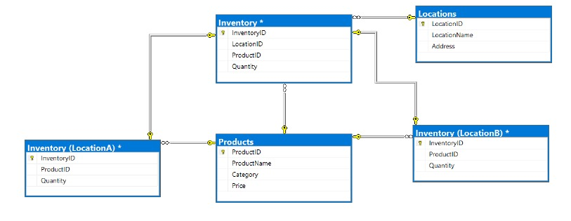
Database Schema

Slide 8
02
Data Distribution
Simulated a distributed database environment by utilizing schemas to represent inventory at different locations.

Slide 9
Data Distribution
2. Simulated Data Distribution
1.Created Separate Schemas:
LocationA schema for inventory at one location.
LocationB schema for inventory at another location.
2. Created Inventory Tables Within Schemas:
LocationA.Inventory: Tracks product inventory for LocationA.
LocationB.Inventory: Tracks product inventory for LocationB.
3.Inserted Data into Schema-Specific Tables:
Populated LocationA.Inventory with products and their quantities.
Populated LocationB.Inventory with different sets of products and quantities.

Slide 10
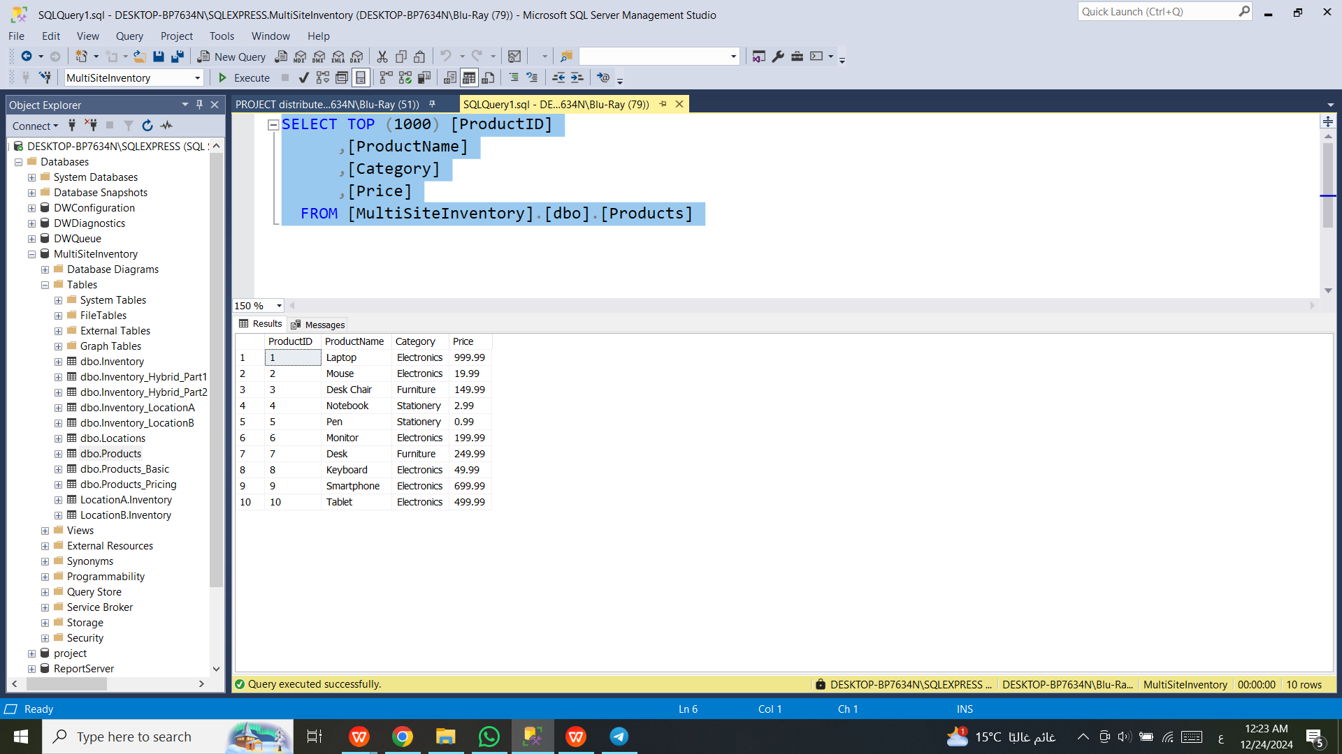
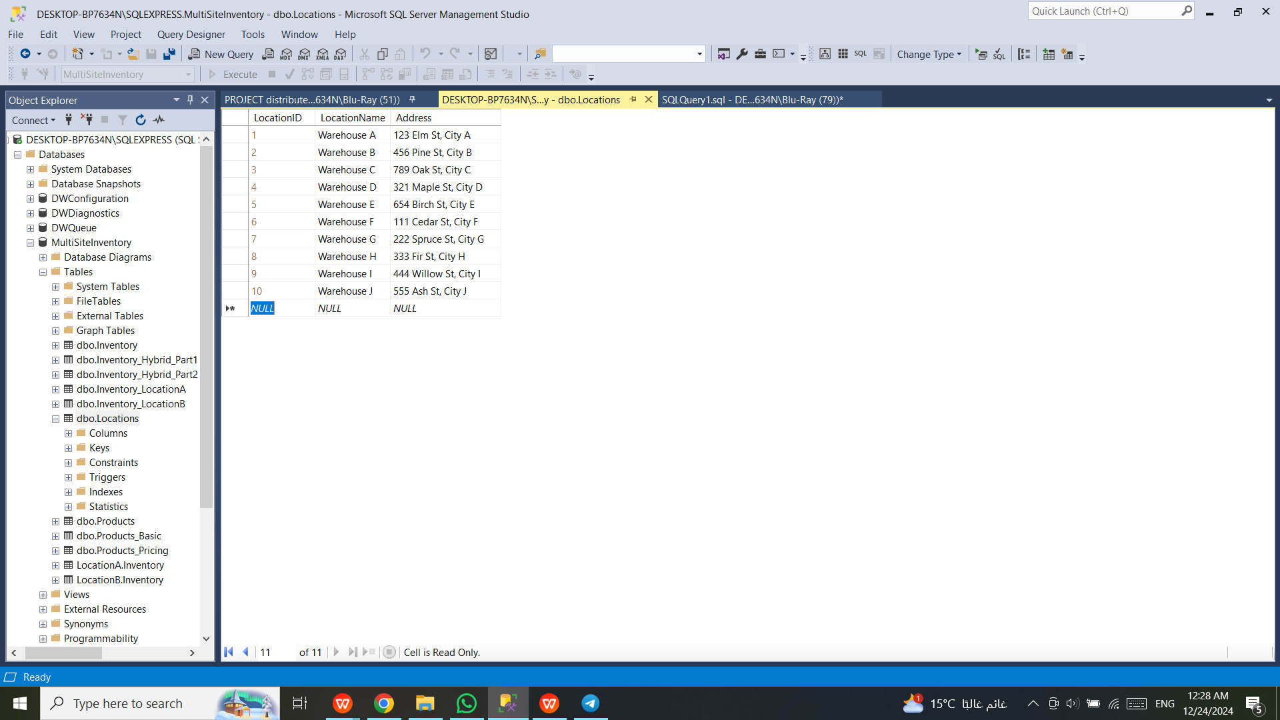
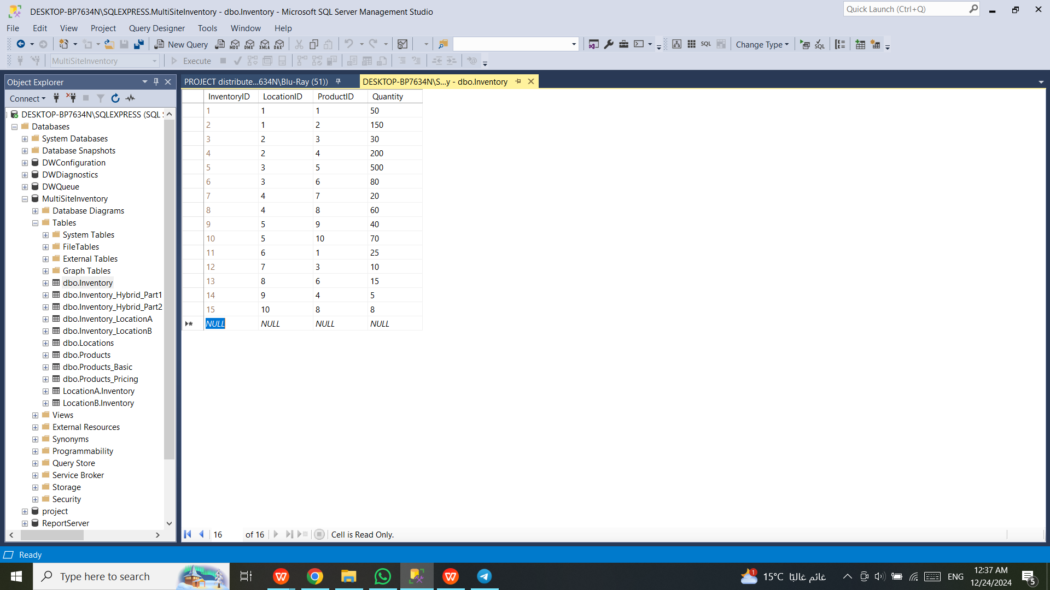
OUt Put
Product
Location
Inventory

Slide 11
03
Transaction Management
Implemented secure and reliable transactions to handle inventory transfers between locations.

Slide 12
Transaction Management
3. Implemented Transaction Management
1.Single-Site Transaction:
Transferred 10 units of a product (ProductID = 1) from LocationA to LocationB.
Used BEGIN TRANSACTION and COMMIT TRANSACTION to ensure consistency.
2.Validated Inventory Levels:
Queried both LocationA.Inventory and LocationB.Inventory to confirm changes.

Slide 13
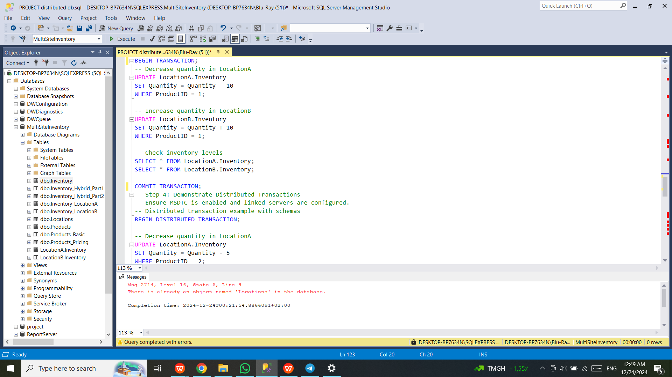
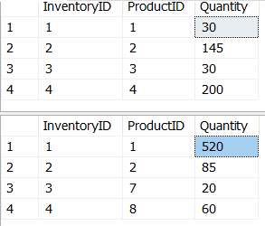
Transaction Management

Slide 14
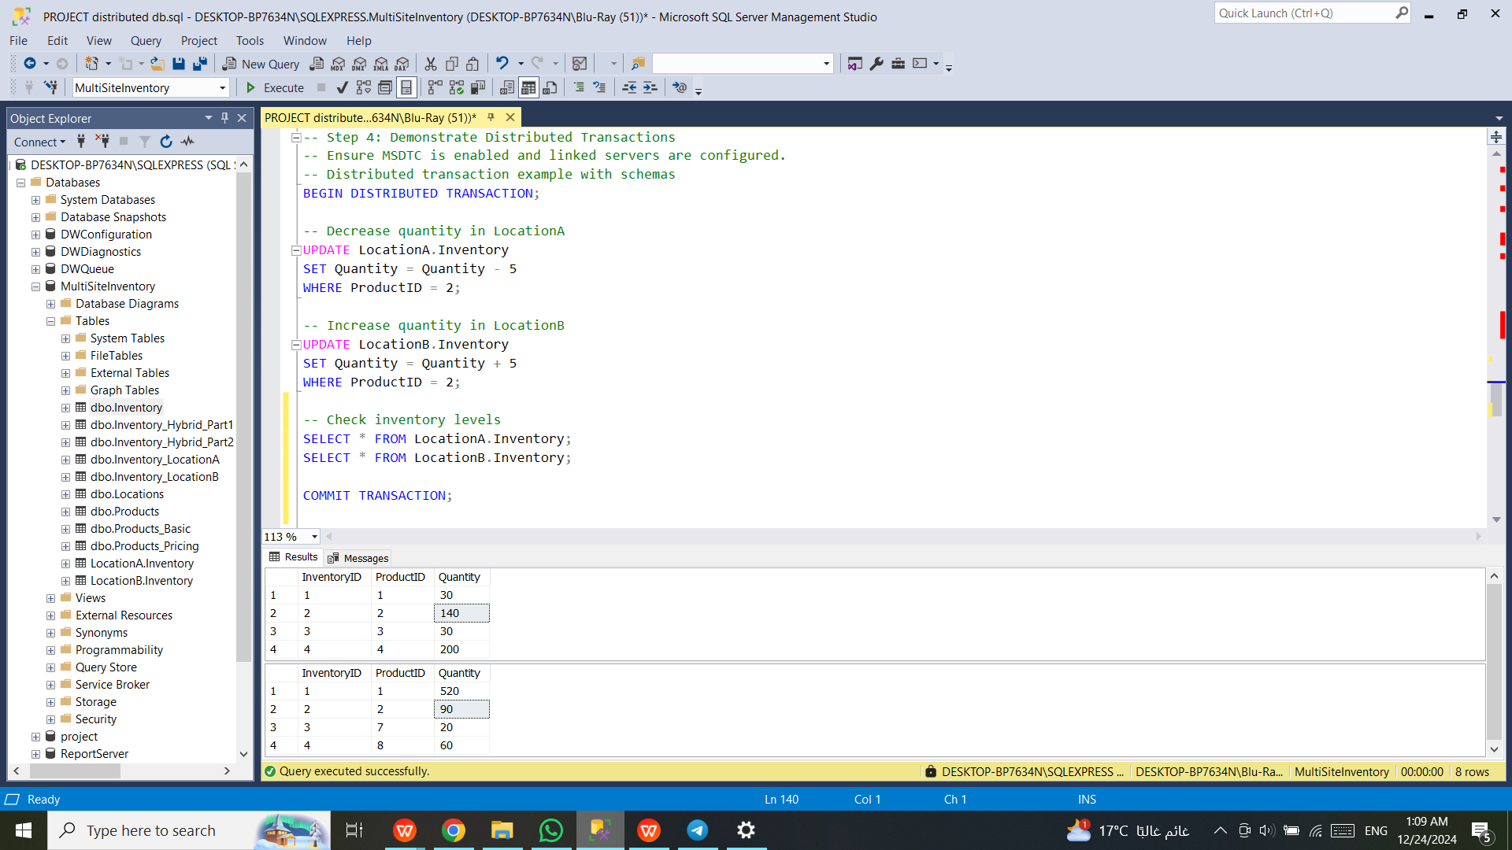
Transaction Management

Slide 15
04
Replication

Slide 16
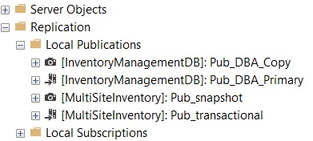
Replication
4. Implemented Replication
We'll configure mixed replication (snapshot and transactional) using SQL Server
Management Studio. This process involves:
Configuring a distributor.
Creating a publication for replication.
Setting up subscriptions.

Slide 17
05
Reporting
Reporting capabilities to provide insights into overall inventory levels.

Slide 18
Reporting
5. Reporting Functionality
Created an Aggregate Report:
Queried data from Inventory, Products, and Locations tables.
Displayed overall inventory levels grouped by ProductName, LocationName, and InventoryID.
Sorted results for readability.

Slide 19
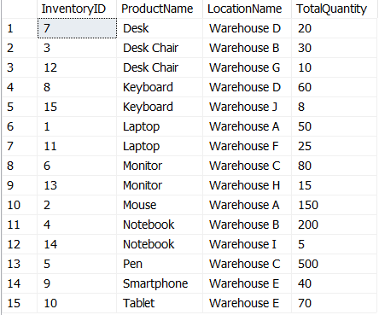
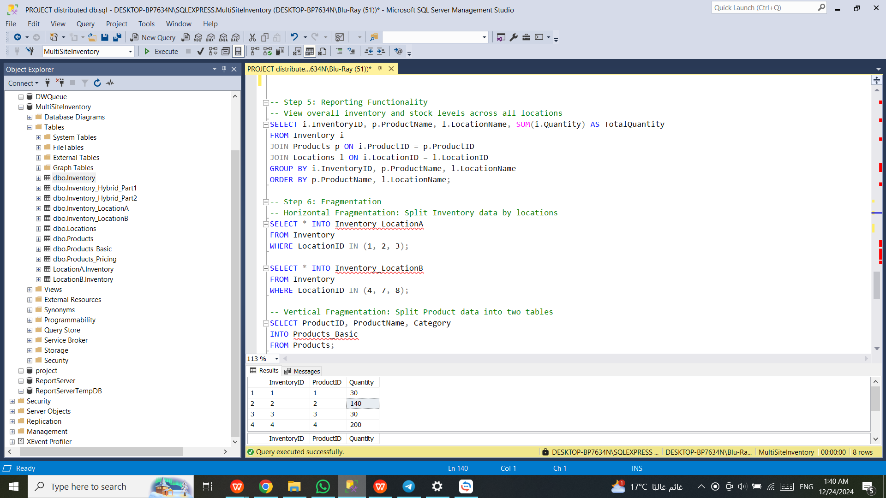
Transaction Management

Slide 20
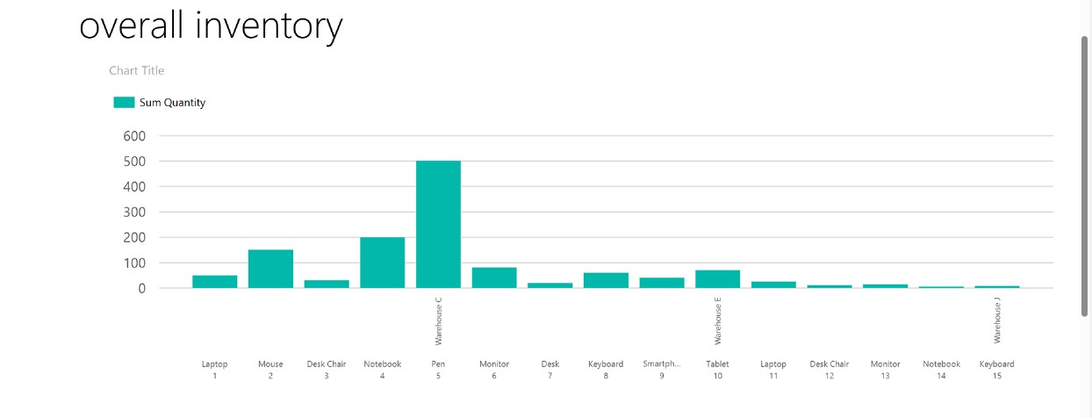
Transaction Management

Slide 21
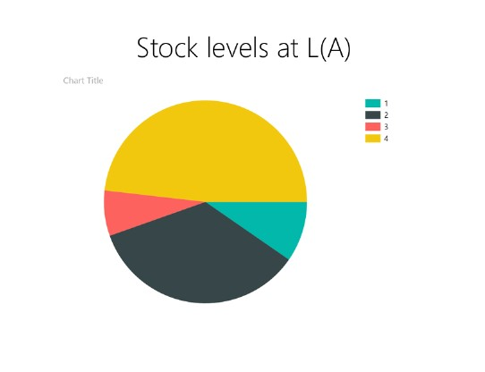
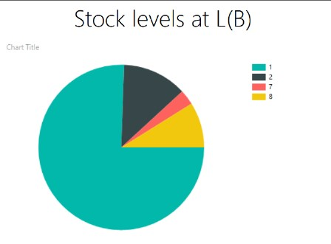
Transaction Management

Slide 22
06
Fragmentation
Examples for horizontal, vertical, and hybrid fragmentation are implemented.

Slide 23
Fragmentation
6. Fragmentation
1.Horizontal Fragmentation:
Split the Inventory table into Inventory_LocationA and Inventory_LocationB based on LocationID.
2.Vertical Fragmentation:
Divided the Products table into:
Products_Basic (containing non-sensitive product details).
Products_Pricing (containing pricing data only).
3. Hybrid Fragmentation:
Combined horizontal and vertical fragmentation:
Created Inventory_Hybrid_Part1 with InventoryID and ProductID for specific locations.
Created Inventory_Hybrid_Part2 with LocationID and Quantity for remaining locations.

Slide 24
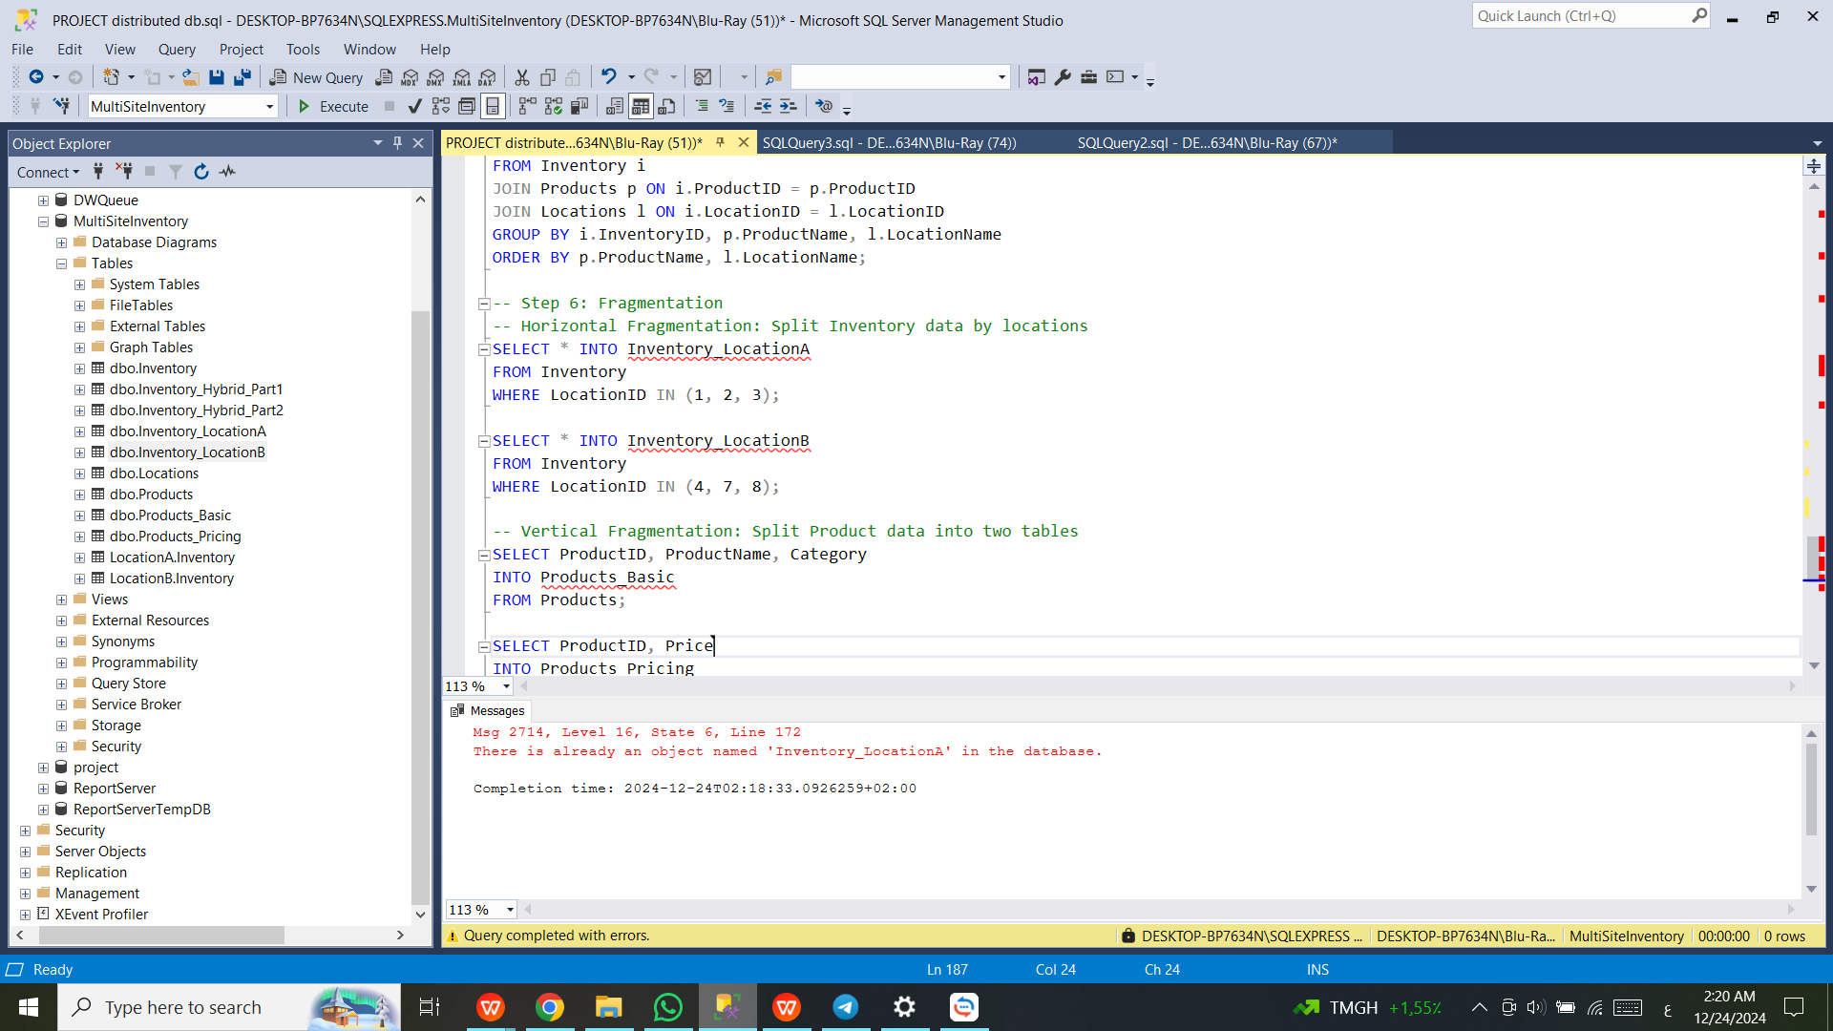
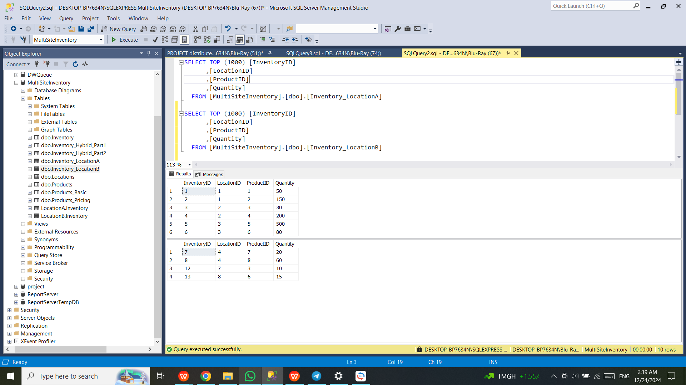
Horizontal Fragmentation

Slide 25
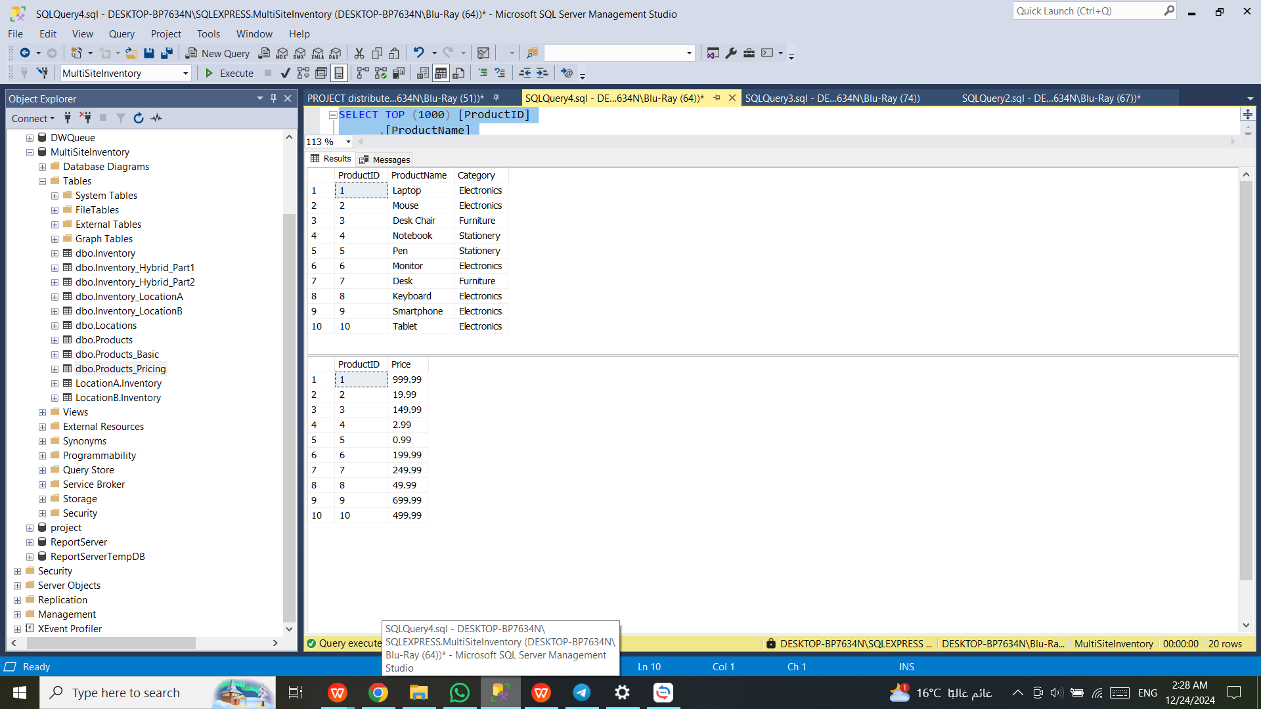
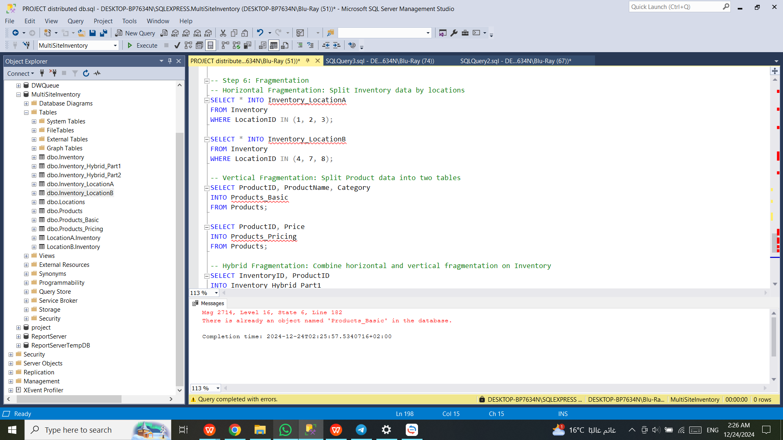
Vertical Fragmentation

Slide 26
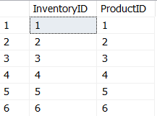
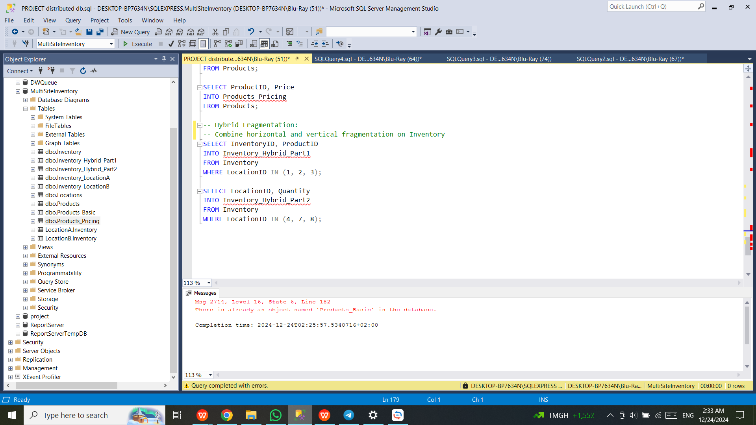
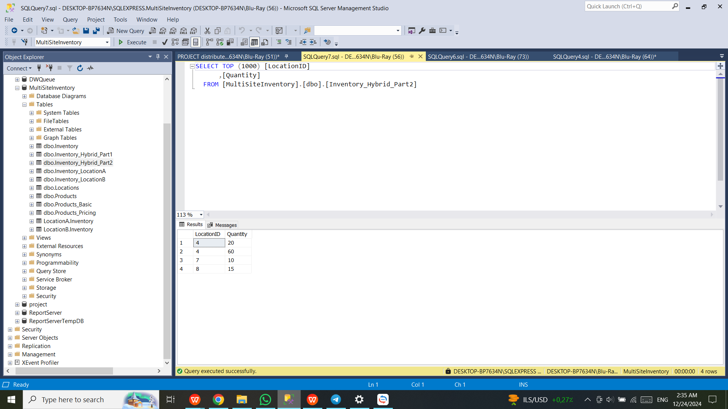
Hybrid Fragmentation

Slide 27
07
User Interface
Inventory Management System GUI

Slide 28
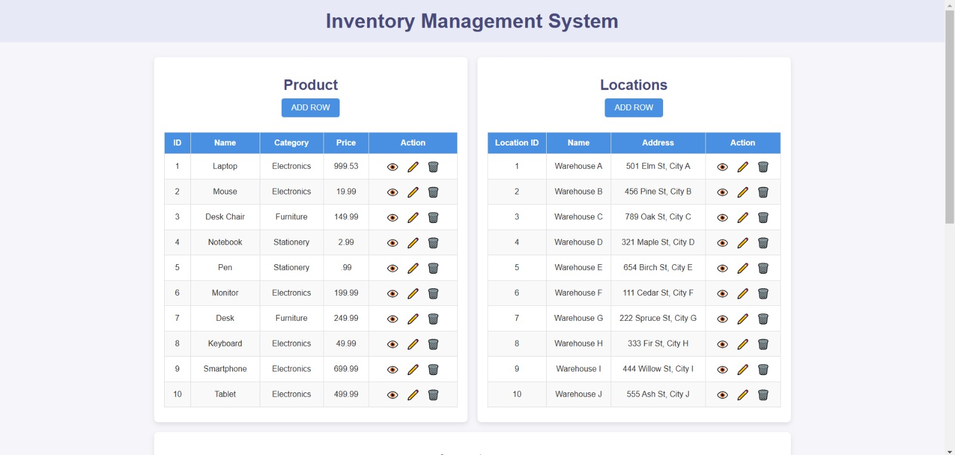
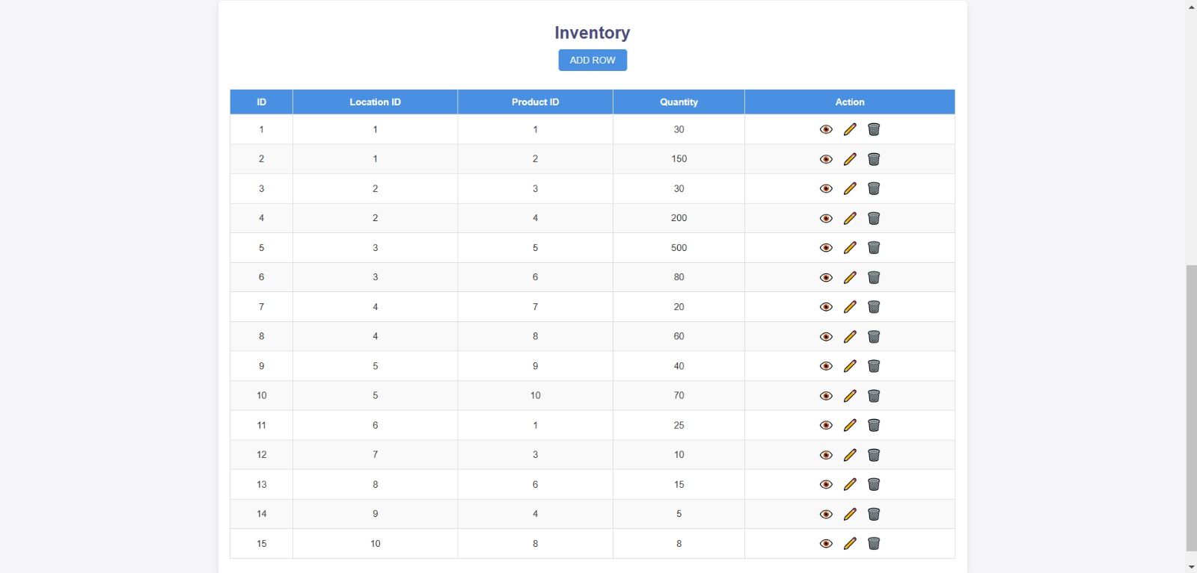

Slide 29

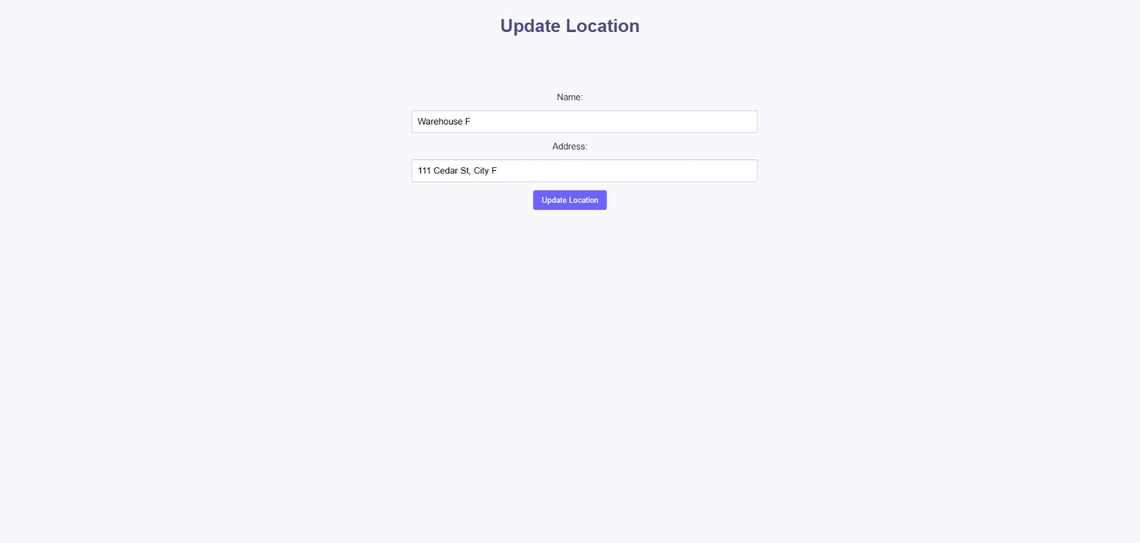
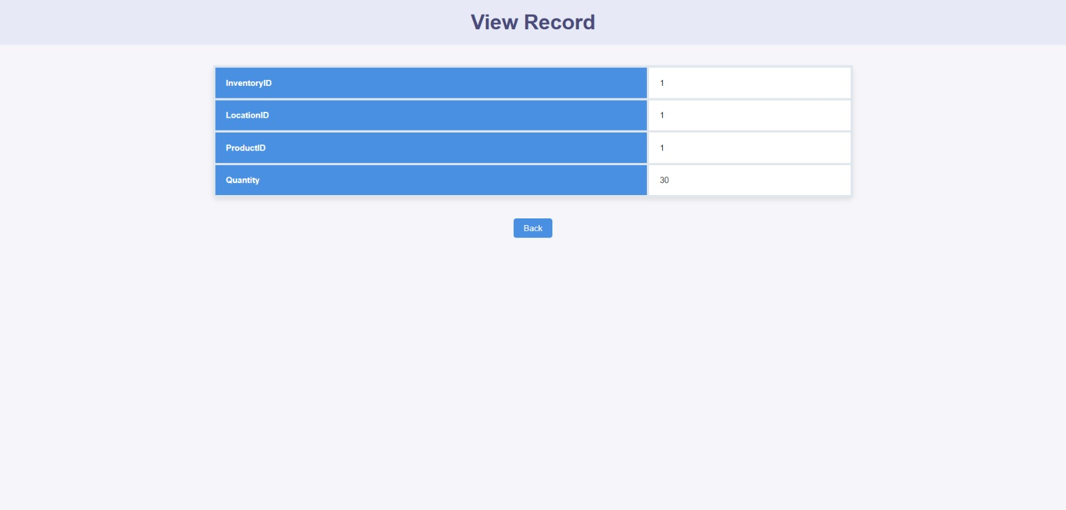

Slide 30
Thank you

